Slide 1

Mathematical Functions, Character and Strings
Introduce mathematical functions, characters, string objects, and use them to develop programs.
Java provides many useful methods in the Math class for performing common mathematical functions.

Slide 2
Mathematical Functions, Character and Strings
Methods of Math calss can be categorized as:
Trigonometric methods
Exponent methods and
Service methods
Service methods include the rounding, min, max, absolute, and random methods.
In addition to methods, the Math class provides two useful double constants, PI and E (the base of natural logarithms).
We can use these constants as Math.PI and Math.E in any program.

Slide 3
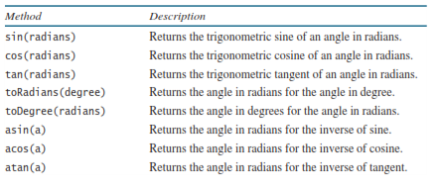
Trigonometric Methods

Slide 4
Trigonometric Methods
The parameter for sin, cos, and tan is an angle in radians.
The return value for asin, acos, and atan is a degree in radians in the range between -π/2 and π /2.
One degree is equal to π /180 in radians, 90 degrees is equal to π /2 in radians, and 30 degrees is equal to π /6 in radians.

Slide 5
Trigonometric Methods
For example,
Math.toDegrees(Math.PI / 2) returns 90.0
Math.toRadians(30) returns 0.5236 (same as π/6)
Math.sin(0) returns 0.0
Math.sin(Math.toRadians(270)) returns -1.0
Math.sin(Math.PI / 6) returns 0.5
Math.sin(Math.PI / 2) returns 1.0
Math.cos(0) returns 1.0
Math.cos(Math.PI / 6) returns 0.866
Math.cos(Math.PI / 2) returns 0
Math.asin(0.5) returns 0.523598333 (same as π/6)
Math.acos(0.5) returns 1.0472 (same as π/3)
Math.atan(1.0) returns 0.785398 (same as π/4)

Slide 6
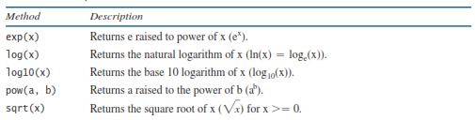
Exponent Methods

Slide 7
Exponent Methods
For example,
Math.exp(1) returns 2.71828
Math.log(Math.E)returns 1.0
Math.log10(10)returns 1.0
Math.pow(2,3)returns 8.0
Math.pow(3, 2) returns 9.0
Math.pow(4.5,2.5)returns 22.91765
Math.sqrt(4)returns 2.0
Math.sqrt(10.5)returns 4.24

Slide 8
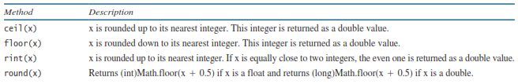
Rounding Methods

Slide 9
Rounding Methods
For example,
Math.ceil(2.1) returns 3.0
Math.ceil(2.0) returns 2.0
Math.ceil(-2.0) returns –2.0
Math.ceil(-2.1) returns -2.0
Math.floor(2.1) returns 2.0
Math.floor(2.0) returns 2.0
Math.floor(-2.0) returns –2.0
Math.floor(-2.1) returns -3.0

Slide 10
Rounding Methods
For example,
Math.rint(2.1) returns 2.0
Math.rint(2.0) returns 2.0
Math.rint(-2.0) returns –2.0
Math.rint(-2.1) returns -2.0
Math.rint(2.5) returns 2.0
Math.rint(-2.5) returns -2.0
Math.round(2.6f) returns 3
Math.round(2.0) returns 2
Math.round(-2.0f) returns -2
Math.round(-2.6) returns -3

Slide 11
min, max, and abs Methods
The min and max methods return the minimum and maximum numbers of two numbers (int, long, float, or double).
Example:
max(4.4, 5.0) returns 5.0, and min(3, 2) returns 2
The abs method returns the absolute value of the number (int, long, float, or double).
For example,
Math.max(2, 3) returns 3
Math.max(2.5, 3) returns 4.0
Math.min(2.5, 4.6) returns 2.5
Math.abs(-2) returns 2
Math.abs(-2.1) returns 2.1

Slide 12
The random Method
It generates a random double value greater than or equal to 0.0 and less than 1.0 (0 <= Math.random() < 1.0).
We can use it to write a simple expression to generate random numbers in any range.
For example,
(int)(Math.random() * 10)
50 + (int)(Math.random() * 50)
In general,
a + Math.random() * b
Returns a random integer between 0 and 9.
Returns a random integer between 50 and 59.
Returns a random integer between a and b.

Slide 13
Character Data Type
A character data type represents a single character.
The character data type, char, is used to represent a single character.
A character literal is enclosed in single quotation marks.
Consider the following code:
char letter = 'A’;
char numChar = '4';
Assigns character A to the char variable letter.
Assigns digit character 4 to the char variable numChar.

Slide 14
Unicode and ASCII Code
Mapping a character to its binary representation is called encoding.
Java supports Unicode, an encoding scheme established by the Unicode Consortium to support the interchange, processing, and display of written texts in the world’s diverse languages.
Unicode – originally designed as a 16-bit (65,536) character encoding.
Unicode – extended to allow up to 1,112,064 characters.
Those characters that go beyond the original 16-bit limit are called supplementary characters.
Java supports the supplementary characters.
We will consider only the original 16-bit Unicode characters.

Slide 15
Unicode and ASCII Code
A 16-bit Unicode takes two bytes, preceded by \u, expressed in four hexadecimal digits that run from \u0000 to \uFFFF.
Example:
The Unicodes for the Greek letters α β γ are \u03b1 \u03b2 \u03b4.

Slide 16
Unicode and ASCII Code
Most computers use ASCII (American Standard Code for Information Interchange)
It is a 8-bit encoding scheme for representing all uppercase and lowercase letters, digits, punctuation marks, and control characters.
Unicode includes ASCII code, with \u0000 to \u007F corresponding to the 128 ASCII characters.

Slide 17
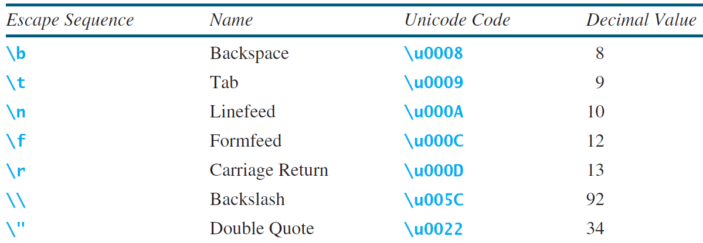
Escape Sequence for Special Characters

Slide 18
Escape Sequence for Special Characters
Can you write a statement like this?
System.out.println("He said "Java is fun"");
Java uses a special notation to represent special characters, called an escape sequence, consists of a backslash ( \) followed by a character or a combination of digits.
Example:
\t is an escape sequence for the Tab character and
\u03b1 is an escape sequence to represent a Unicode.
The symbols in an escape sequence are interpreted as a whole rather than individually.
An escape sequence is considered as a single character.
System.out.println("He said \"Java is fun\"");
Output: He said "Java is fun"

Slide 19
Casting between char and Numeric Types
When an integer is cast into a char, only its lower 16 bits of data are used; the other part is ignored.
Example:
char ch = (char)0XAB0041; // The lower 16 bits hex code 0041 is assigned to ch
System.out.println(ch); // ch is character A
When a floating-point value is cast into a char, the floating-point value is first cast into an int, which is then cast into a char.
char ch = (char)65.25; // Decimal 65 is assigned to ch
System.out.println(ch); // ch is character A
When a char is cast into a numeric type, the character’s Unicode is cast into the specified numeric type.
int i = (int)'A'; // The Unicode of character A is assigned to i
System.out.println(i); // i is 65

Slide 20
Casting between char and Numeric Types
Implicit casting can be used if the result of a casting fits into the target variable. Otherwise, explicit casting must be used.
Example:
since the Unicode of 'a' is 97, which is within the range of a byte, these implicit castings are fine:
byte b = 'a’;
int i = 'a';
But the following casting is incorrect, because the Unicode \uFFF4 cannot fit into a byte:
byte b = '\uFFF4';
To force this assignment, use explicit casting, as follows:
byte b = (byte)'\uFFF4';
Any positive integer between 0 and FFFF in hexadecimal can be cast into a character implicitly. Any number not in this range must be cast into a char explicitly.

Slide 21
Casting between char and Numeric Types
What will be the output of the following code:
int i = '2' + '3';
System.out.println("i is " + i);
int j = 2 + 'a’;
System.out.println("j is " + j);
System.out.println(j + " is the Unicode for character "
+ (char)j);
System.out.println("Chapter " + '2');

Slide 22
Comparing and Testing Characters
Two characters can be compared using the relational operators just like comparing two numbers.
if (ch >= 'A' && ch <= 'Z')
System.out.println(ch + " is an uppercase letter");
else if (ch >= 'a' && ch <= 'z’)
System.out.println(ch + " is a lowercase letter");
else if (ch >= '0' && ch <= '9’)
System.out.println(ch + " is a numeric character");

Slide 23
Comparing and Testing Characters

Slide 24
The String Type
A string is a sequence of characters.
To represent a string of characters, use the data type called String.
Example:
String message = "Welcome to Java";
declares message to be a string with the value "Welcome to Java".

Slide 25
The String Type
String is a predefined class in the Java library, just like the classes System and Scanner.
The String type is not a primitive type. It is known as a reference type.

Slide 26
Simple Methods for String Objects

Slide 27
Getting String Length
Example:
String message = "Welcome to Java";
System.out.println("The length of " + message + " is " + message.length());
Output:
The length of Welcome to Java is 15

Slide 28
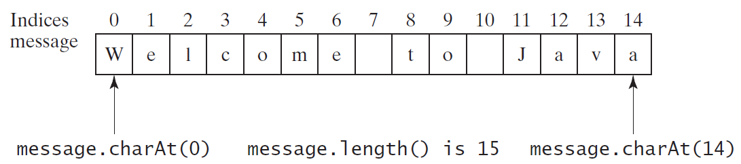
Getting characters from a String
Example:
String message = "Welcome to Java";
System.out.println("The first character in message is " + message.charAt(0));
Output:
The first character in message is W

Slide 29
Converting Strings
Example:
System.out.println("The converted string is " + “Welcome”.toLowerCase();
System.out.println("The converted string is " + “Welcome”.toUpperCase();
System.out.println("The converted string is " + “Welcome to Java“.trim();
Output:
The converted string is welcome
The converted string is WELCOME
The trimmed string is WelcometoJava

Slide 30
String Concatenation
To concatenate strings s1 and s2 into s3:
String s3 = s1.concat(s2);
Because string concatenation is heavily used in programming, Java provides a convenient way to accomplish it.
We can use the plus (+) operator to concatenate two strings.
String s3 = s1 + s2;
Example:
String myString = message + " and " + "HTML";

Slide 31
String Concatenation
The + operator can also concatenate a number with a string.
The number is first converted into a string and then concatenated.
Note: At least one of the operands must be a string in order for concatenation to take place.
Example:
String message = "Welcome " + "to " + "Java";
String s = "Chapter" + 2;
String s1 = "Supplement" + 'B';

Slide 32
String Concatenation
The augmented += operator can also be used for string concatenation.
Example:
If message string is "Welcome to Java”,
message += " and Java is fun";
New value of message is "Welcome to Java and Java is fun".

Slide 33
String Concatenation
If i = 1 and j = 2, what is the output of the following statement?
System.out.println("i + j is " + i + j);
Output: "i + j is 12"
To force i + j to be executed first, enclose i + j in the parentheses, as follows:
System.out.println("i + j is " + (i + j));

Slide 34
Reading a String from Console
To read a string from the console, invoke the next() method on a Scanner object.
Example:
Scanner input = new Scanner(System.in);
System.out.print("Enter three words separated by spaces: ");
String s1 = input.next();
String s2 = input.next();
String s3 = input.next();
System.out.println("s1 is " + s1);
System.out.println("s2 is " + s2);
System.out.println("s3 is " + s3);

Slide 35
Reading a String from Console
The next() method reads a string that ends with a whitespace character.
We can use the nextLine() method to read an entire line of text.
The nextLine() method reads a string that ends with the Enter key pressed.
Example:
Scanner input = new Scanner(System.in);
System.out.println("Enter a line: ");
String s = input.nextLine();
System.out.println("The line entered is " + s);

Slide 36
Reading a String from Console
Important Note:
To avoid input errors, do not use nextLine() after nextByte(), nextShort(), nextInt(), nextLong(), nextFloat(), nextDouble(), or next().
The reasons will be explained later on when we will discuss, ‘How Does Scanner Work?’

Slide 37
Reading a String from Console
Important Note:
To avoid input errors, do not use nextLine() after nextByte(), nextShort(), nextInt(), nextLong(), nextFloat(), nextDouble(), or next().
The reasons will be explained later on when we will discuss, ‘How Does Scanner Work?’

Slide 38
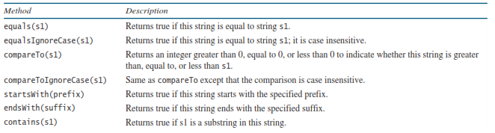
Comparing Strings

Slide 39
Comparing Strings
if (string1 == string2)
System.out.println("string1 and string2 are the same object");
else
System.out.println("string1 and string2 are different objects");
The == operator checks only whether string1 and string2 refer to the same object; it does not tell you whether they have the same contents.
Therefore, you cannot use the == operator to find out whether two string variables have the same contents.

Slide 40
Comparing Strings
if (string1.equals(string2))
System.out.println("string1 and string2 have the same contents");
else
System.out.println("string1 and string2 are not equal");
Example:
String s1 = "Welcome to Java";
String s2 = "Welcome to Java";
String s3 = "Welcome to C++";
System.out.println(s1.equals(s2)); // true
System.out.println(s1.equals(s3)); // false

Slide 41
Comparing Strings
The compareTo method can also be used to compare two strings.
Example:
s1.compareTo(s2)
The method returns the value 0 if s1 is equal to s2, a value less than 0 if s1 is lexicographically (i.e., in terms of Unicode ordering) less than s2, and a value greater than 0 if s1 is lexicographically greater than s2.
Example:
s1 is abc and s2 is abg, and s1.compareTo(s2) returns -4.

Slide 42
Comparing Strings
Example:
"Welcome to Java".startsWith("We") returns true.
"Welcome to Java".startsWith("we") returns false.
"Welcome to Java".endsWith("va") returns true.

Slide 43

Obtaining Substrings

Slide 44
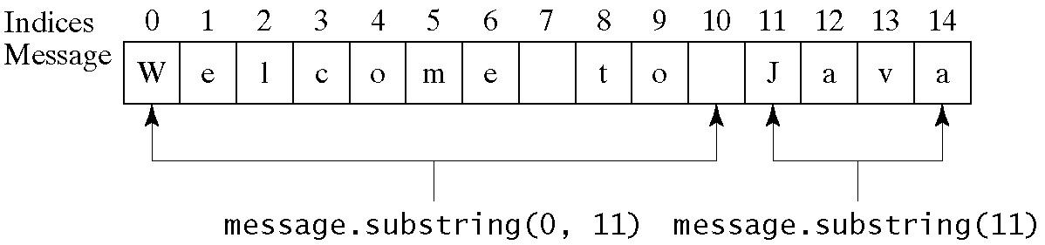
Obtaining Substrings
Example:
String message = "Welcome to Java";
String message = message.substring(0, 11) + "HTML";
The string message now becomes Welcome to HTML.

Slide 45
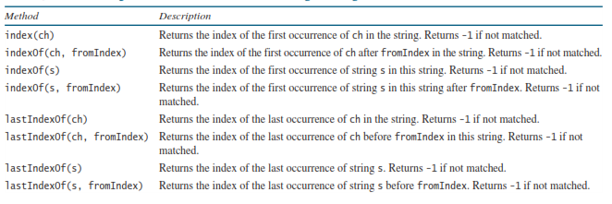
Finding a Character or a Substring in a String

Slide 46
Finding a Character or a Substring in a String
Example:
"Welcome to Java".indexOf('W') returns 0.
"Welcome to Java".indexOf('o') returns 4.
"Welcome to Java".indexOf('o', 5) returns 9.
"Welcome to Java".indexOf("come") returns 3.
"Welcome to Java".indexOf("Java", 5) returns 11.
"Welcome to Java".indexOf("java", 5) returns -1.

Slide 47
Finding a Character or a Substring in a String
Example:
"Welcome to Java".lastIndexOf('W') returns 0.
"Welcome to Java".lastIndexOf('o') returns 9.
"Welcome to Java".lastIndexOf('o', 5) returns 4.
"Welcome to Java".lastIndexOf("come") returns 3.
"Welcome to Java".lastIndexOf("Java", 5) returns -1.
"Welcome to Java".lastIndexOf("Java") returns 11.

Slide 48
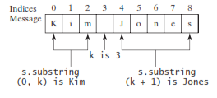
Finding a Character or a Substring in a String
String s contains the first name and last name separated by a space. Write a code to extract the first name and last name from the string:

Slide 49
Conversion between Strings and Numbers
To convert a string into an int value, use the Integer.parseInt method, as follows:
int intValue = Integer.parseInt(intString); where intString is a numeric string such as "123".
To convert a string into a double value, use the Double.parseDouble method, as follows:
double doubleValue = Double.parseDouble(doubleString); where doubleString is a numeric string such as "123.45".
If the string is not a numeric string, the conversion would cause a runtime error.
The Integer and Double classes are both included in the java.lang package, and thus they are automatically imported.
You can convert a number into a string, simply use the string concatenating operator as follows:
String s = number + "";

Slide 50
Any Questions?

